Slide 1
Navigating Evasion:
Advances in LLM-Based Malware Detection
and LLVM Challenge
Ekin Böke
Advisor: Simon Torka

Slide 2


Evolution of Malware Detection
Traditional Methods
Signature-based detection → Ineffective against zero-day & polymorphic malware
Machine Learning (ML) Revolution
Techniques:
Static Analysis – Code inspection
Dynamic Analysis – Observes behavior
Hybrid Analysis – Combines both
Early ML Models
SVMs, Random Forests → Needed manual feature engineering
Deep Learning Shift: MalConv [1] analyzed raw binaries directly

Slide 3

LLMs in Malware Detection
Why LLMs?
Analyze entire code structure, not just extracted features
Detect obfuscated & polymorphic malware more effectively
How They Improve Detection
Capture long-range dependencies in code
Understand malicious intent beyond syntax patterns
Key Takeaways
Evolution: Signature → ML → Deep Learning → LLMs
LLMs improve detection accuracy & adaptability
Challenges: Scalability & resistance to adversarial attacks

Slide 4
LLMs for Code Analysis
How LLMs Assist Malware Detection
Models like GPT-3 & BERT process large-scale text representations
Capture syntax & semantic patterns
CodeBERT & CodeGPT – Fine-tuned for programming tasks
Used for vulnerability detection, malware classification, and code repair
Limitations
Operate at token/sequence level → Can miss deeper structural relationships
Lack explicit modeling of program flow like ASTs & CFGs

Slide 5
Domain-Specific LLMs for Malware Detection
CodeBERT for Code Representation [2]
Pre-trained on source code & natural language pairs
Designed for tasks like code search, code summarization, and translation
Captures semantic relationships in programming languages
MalBERT for Android Malware [3]
Fine-tuned on Androzoo dataset
Identifies API misuse, control flow obfuscation, & hidden payloads
Demonstrates how domain-specific LLMs enhance security analysis
DSLM-GPT2 vs. BiLSTM [4]
DSLM-GPT2 (pre-trained on assembly) → F1 score: 86.0%
BiLSTM-based model (DLAM) → F1 score: 98.3%
Highlights LLM weaknesses in broader contextual analysis

Slide 6
Introduction to Malware Obfuscation
What is Malware Obfuscation?
Techniques used to hide malicious code and evade detection
Modifies structure & behavior without changing functionality
Types of obfuscation
Syntactic – Changes code structure (e.g., variable renaming, dead code insertion)
Semantic – Alters execution logic (e.g., control flow distortion, instruction substitution)
Behavioral – Modifies runtime behavior (e.g., encryption, polymorphism, metamorphism)

Slide 7
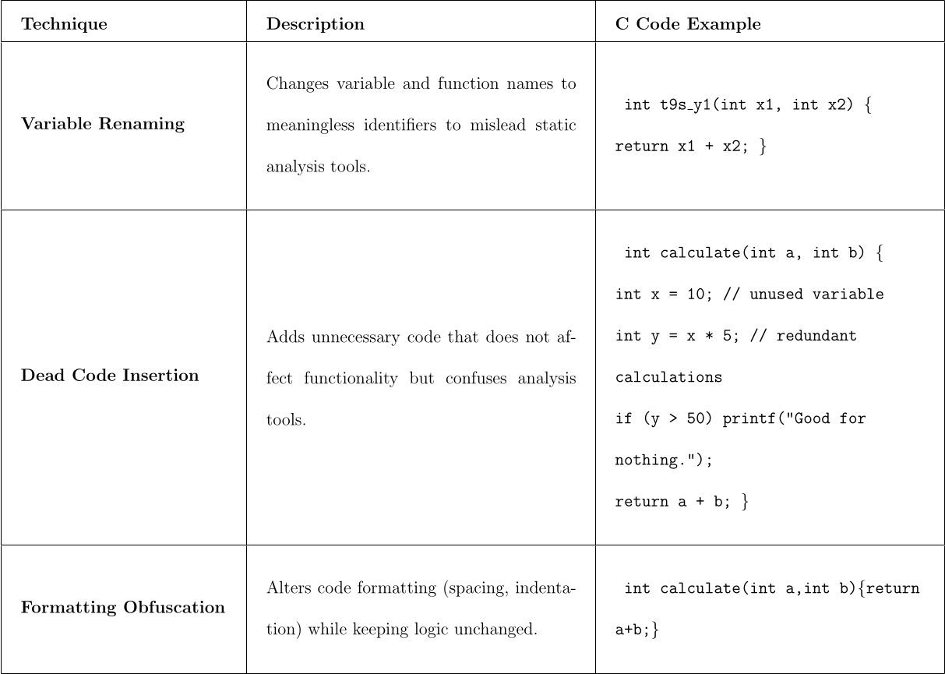
Syntactic Obfuscation

Slide 8
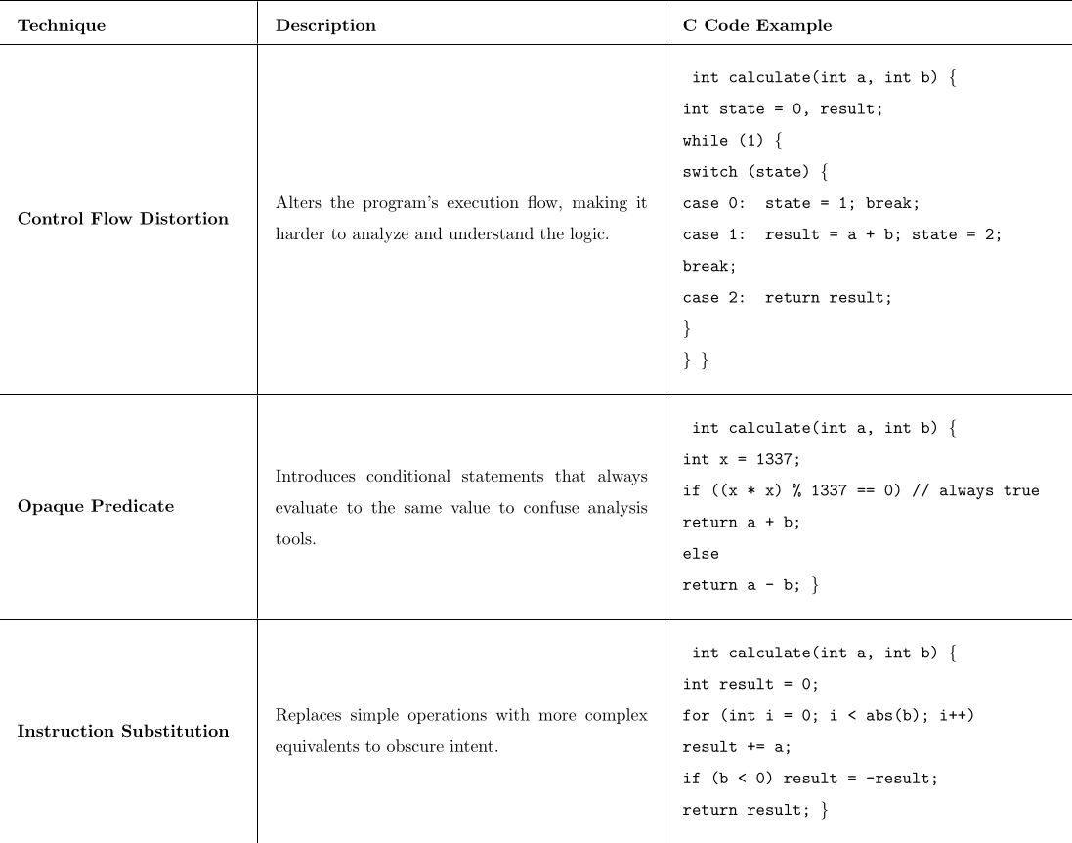
Semantic Obfuscation

Slide 9

LLVM and Its Role in Code Transformation
What is LLVM?
A modular compiler infrastructure for optimizers, debuggers, and static analyzers
Enables code obfuscation and transformation
Provides fine-grained control over code manipulation
LLVM Intermediate Representation (IR)
Platform-independent abstraction for cross-language compatibility
Based on Static Single Assignment (SSA) form for efficient analysis
Strongly typed & explicit memory management
Enables advanced optimizations (e.g., function inlining, constant propagation)

Slide 10
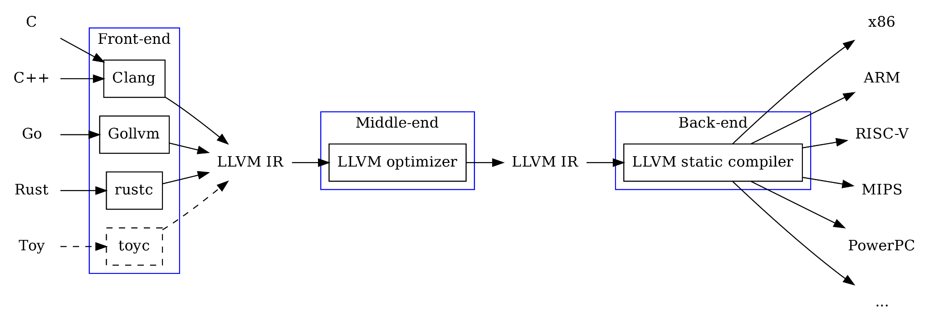
High Level Architecture of LLVM [5]

Slide 11
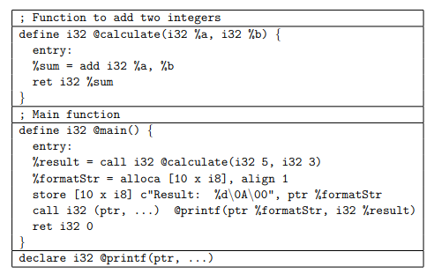
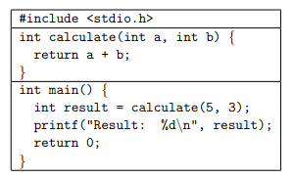
LLVM and Its Role in Code Transformation
compile with clang
-emit llvm

Slide 12

LLVM-Based Obfuscation: Techniques & Challenges
Conditional Code Obfuscation (CCO) – Sharif et al. (2008) [6]
Alters program execution based on its environment.
Enables malware to evade detection in sandboxes and debuggers.
Implemented using an LLVM-based framework at the compiler level.
Obfuscator-LLVM (O-LLVM) – Junod et al. (2015) [7]
Key Difference from CCO:
CCO dynamically alters execution at runtime.
O-LLVM applies static code transformations.
Integrated into LLVM’s modular compilation pipeline.
Designed to hinder reverse engineering tools (e.g., IDA Pro, Ghidra).

Slide 13

LLVM Obfuscation
https://github.com/eshard/obfuscator-llvm
C++ based obfuscator based on LLVM-14
has 4 passes that can be installed with CMAKE
Bogus control flow
Control flow flattening
Instruction-substitution
Basic block splitting

Slide 14
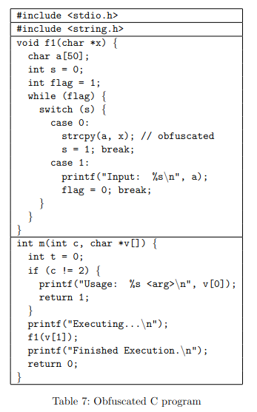
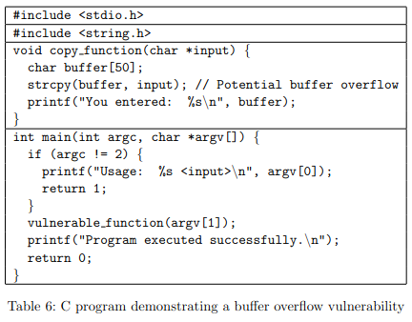
Experimentation with ChatGPT-4o[8]

Slide 15
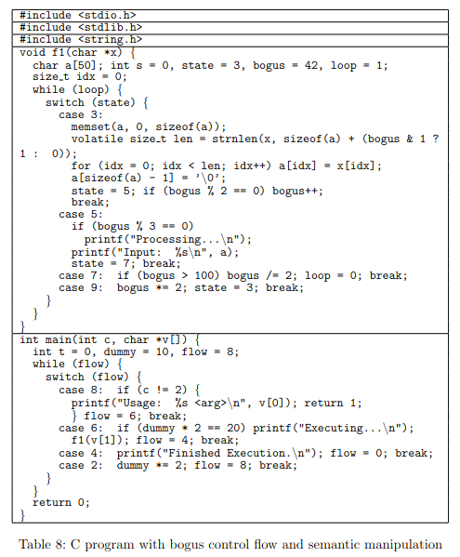
Semantically obfuscated C code

Slide 16
Obfuscation Pipe-line
Step 1: Generate LLVM Bitcode
/usr/local/llvm-14/bin/clang -O1 -S -emit-llvm state_obfuscation.c -o state_obfuscation.bc
Step 2: Apply LLVM Obfuscation
/usr/local/llvm-14/bin/opt --relocation-model=pic \
-load-pass-plugin=/home/boeke/obfuscator-llvm/build/libLLVMObfuscator.so \
-passes="flattening,bogus,substitution,split-basic-blocks" \
state_obfuscation.bc -o state_obfuscation_obfuscated.bc
Step 3: Convert to Object File & Link and Generate the Final Obfuscated Executable
/usr/local/llvm-14/bin/llc --relocation-model=pic -filetype=obj state_obfuscation_obfuscated.bc -o state_obfuscation_obfuscated.o
/usr/local/llvm-14/bin/clang state_obfuscation_obfuscated.o -o state_obfuscation_obfuscated

Slide 17
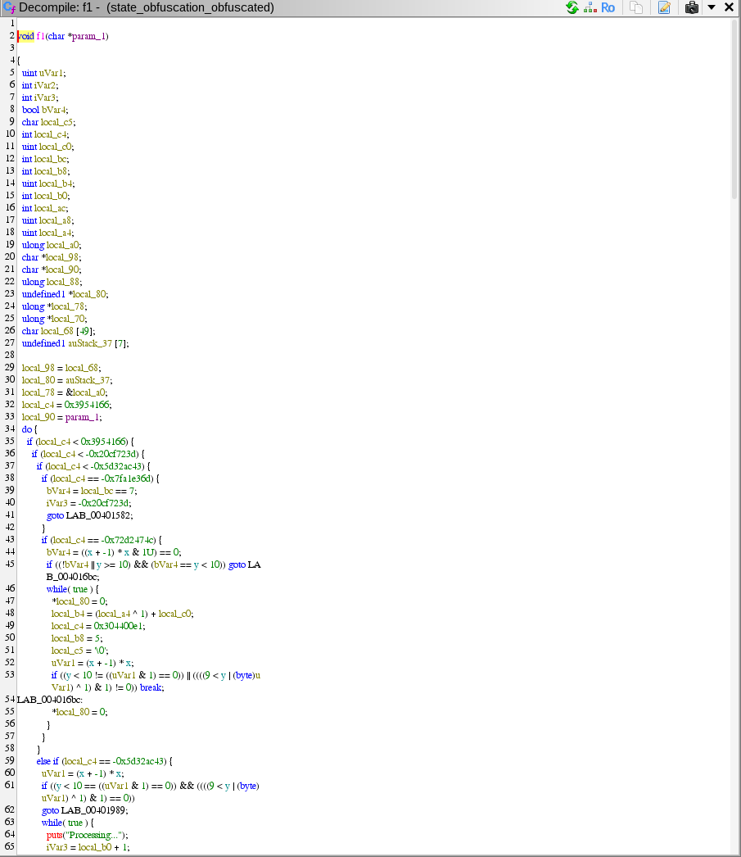
Reverse engineering with Ghidra
Answer from ChatGPT-4o
Conclusion
This function exhibits characteristics of obfuscated binary logic, possibly intended for malware, anti-debugging techniques, or protected proprietary algorithms. It processes an input string, manipulates multiple state variables, and includes non-trivial mathematical operations that affect execution flow. Further analysis (dynamic testing) is required to fully understand its purpose.

Slide 18
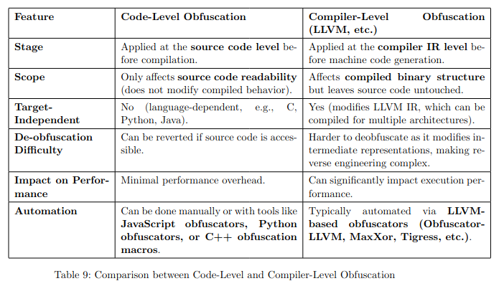
Code vs Compiler Level Obfuscation

Slide 19

Future Directions & Wrap Up
LLVM processes source code into an intermediate representation (IR) before generating machine code.
Obfuscation modifies the IR, making the final compiled binary difficult to analyze.
Architecture Independent
Effective against modern Malware Analysis tools and LLMs
Not enough research on LLVM and safe LLMs

Slide 20



Thank you for Listening! Questions?

Slide 21
References
[1]Edward Raff, Jared Barker, Jonathan Sylvester, Robert Brandon, and Bryan Catanzaro.
Malware detection by eating a whole exe. arXiv preprint arXiv:1710.09435, 2017.
[2]Zhangyin Feng, Daya Guo, Duyu Tang, Nan Duan, Xiaocheng Feng, Ming Gong, Lin-
jun Shou, Ting Liu, Daxin Jiang, and Ming Zhou. Codebert: A pre-trained model for
programming and natural languages. pages 1536–1547, 01 2020.
[3]Abir Rahali and Moulay A. Akhloufi. Malbert: Using transformers for cybersecurity and
malicious software detection. arXiv preprint arXiv:2103.03806, 2021.
[4]Deniz Demirci, Nazenin ¸sahin, Melih ¸sirlanci, and Cengiz Acartürk. Static malware de-
tection using stacked bilstm and gpt-2. IEEE Access, 10:58488–58502, 2022.
[5] Gopher Academy, "LLVM IR and Go," Gopher Academy Advent 2018, Dec. 2018. [Online]. Available: https://blog.gopheracademy.com/advent-2018/llvm-ir-and-go/
[6]Mohammad Sharif, Andrea Lanzi, Jonathon Giffin, and Wenke Lee. Impeding malware
analysis using conditional code obfuscation. In Network and Distributed System Security
Symposium (NDSS), 2008.
[8]OpenAI, "ChatGPT-4o," OpenAI, 2024. [Online]. Available: https://openai.com. [Accessed: 5-Mar-2025].

